Slide 1
Things in IOT

Slide 2
What IoT provide Us?
It is a actual device that performs specific sensing or actuating function
IoT is outcome of combining IT and OT
IoT provide us
Computing functionality
Data storage
Network connectivity
Technological capabilities like remote access for monitoring , configuration and trouble shooting
can analyze the data of the physical world and use results for better decision making
can anticipate future events

Slide 3
What capabilities IoT should have?
At high level IoT should Have…..
Transducer Capabilities
To interact with physical world
Acts as bridge to connect digital and physical world
Interface Capabilities
Device to device
External world to device
Human to device
Supporting Capabilities
Device management
Security
Privacy

Slide 4
What capabilities IoT should have?
TRANSDUCER CAPABILITIES
Iot has two transducer Capabilities:------
Sensing Capability: provide an observation of an aspect in the form measurement data
Example: temperature measurement ,optical sensing, audio sensing
Actuating Capability: ability to change some thing in the physical world
Example: turn off AC, open a door, robotics movement

Slide 5
What capabilities IoT should have?
INTERFACE CAPABILITIES
Iot has major interface Capabilities:------
Application Interface: ability for other computing devices to communicate with an IoT device application
Human user interface: ability for an IoT device and people to communicate with each other
Example: Touch screen, Alexa
Network interface: ability to interface with a communication network for the purpose of communicating data to or from an IoT device.
It connects IoT to internet. It includes both hardware and software
Example: Ethernet ,Wi-Fi

Slide 6
What capabilities IoT should have?
SUPPORTING CAPABILITIES
It provides device management. Security ,cyber security and privacy
All these capabilities work together to provide seamless user experience

Slide 7
Sensors
A sensor is a device that responds to a physical stimulus ( heat, light, sound, pressure, magnetism) and transmit a resulting impulse ( for measurement or operating control)
Sensors convert analog input into digital outputs so that it can be used in computation
Sensors can be linked with your sense organs
Examples: thermometer, finger print sensor, humidity measurement
Sensors help to collect information regarding various parameters like
Pressure , humidity , presence of chemicals etc

Slide 8
Types of Sensors
There are four types of sensors……………
INPUT BASED
Active sensor
Passive Sensor
OUTPUT BASED
Analog Sensor
Digital Sensor
DATA TYPE BASED
Scalar Sensor
Vector Sensor

Slide 9
Types of Sensors
These are types based on INPUT
Active sensor : generates output signal with the help of external power signal
It do not generate signal unless and until activated by an external stimulus
Independently it cannot sense the input
Example : RADAR, ALTIMETER SENSOR
Passive Sensor: generates output signal without the help of external power signal
It does not require any stimulus or voltage
Example: soil moisture, water level sensor

Slide 10
Types of Sensors
These are types based on OUTPUT
Analog sensor : generates analog output i.e continuous output signal with respect to quantity being measured
Analog voltage in the range 0 to 5V or current produced as the output
Example : speed sensor. Light sensor, pressure sensor and temperature sensor
Digital Sensor: generates output signal in digital format or discrete format
It is non continuous signal with time and always represented in “bits” for serial transmission and in “bytes” for parallel transmission
Digital sensor typically consist of sensor, cable and transmitter
Example: smart phones ,digital temperature sensor

Slide 11
Types of Sensors
These are types based on DATA TYPE
Scalar sensor : detects the input parameter only based on its magnitude.
Not affected by the direction of input parameter
Example : temperature sensor. gas sensor, smoke sensor
Vector Sensor: response of the sensor depends on the magnitude of the direction and orientation of the input parameter
Example: motion detector sensor, accelerometer, magnetic field detector

Slide 12
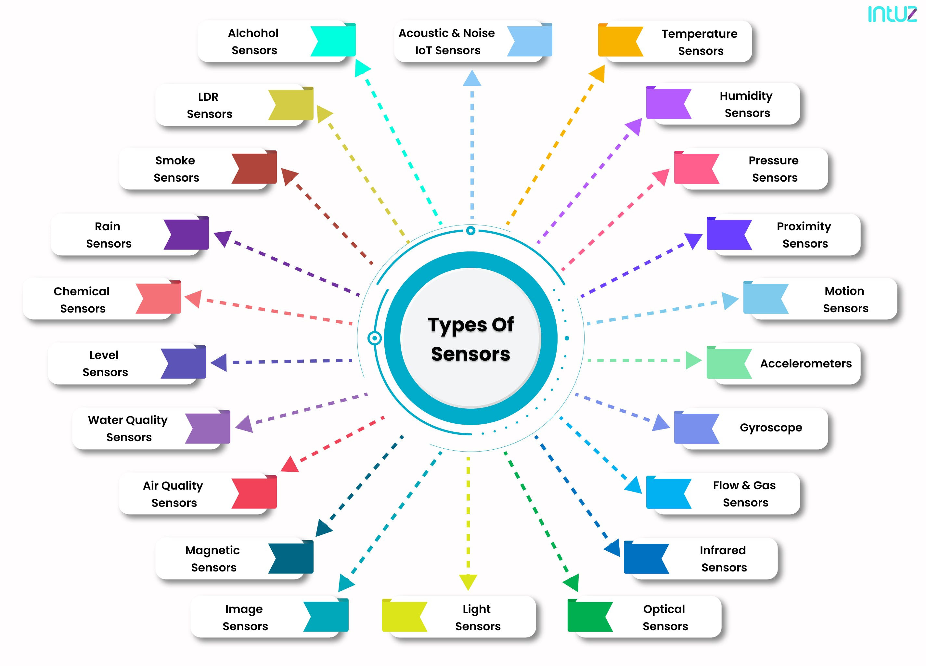

Slide 13
Temperature Sensor
It is used to measure amount of heat energy in an operating environment
Thermocouples: it shows change in voltage based on temperature
Temperature rises then Voltage increases
Thermistors : it is temperature sensitive resistor that changes its physical resistance with the change in temperature
Semiconductors: these are linear devices here the conductivity changes linearly with temperature
Infrared : it detects the temperature by intercepting a portion of emitted infrared energy of the object or substance and sensing its intensity
It can be used to measure temperature of the solids and liquids only
During pandemic these were used to check the body temperature of the person without touching

Slide 14
Proximity Sensor
It is used to detect the presence and absence of near by objects and its properties
Inductive Sensors: they are used for finding the presence of metallic objects and electromagnetic field or beam of electromagnetic radiations
Capacitive Sensors: it can detect both metallic and non metallic objects
Photoelectric Sensors: Photoelectric sensors is made up of light sensitive parts and uses a beam of light to detect the presence or absence of an object
Ultrasonic Sensors: Ultrasonic sensors are also used to detect the presence or to measure the distance of targets similar to RADAR or SONAR

Slide 15
Water Quality Sensor
Chlorine Residual Sensor: it will sense free chlorine present in the water
Organic carbon Sensor: to detect organic elements present in the water
Turbidity Sensor: used to measure suspended particles in the water
Conductivity Sensor: conductivity measurements are carried out in industrial processes to obtain total ionic concentration in water
PH sensor: it is used to measure the PH level of the water to find out whether water is acidic or alkaline
Oxygen-Reduction Potential Sensor: it helps to detect the OXIDATION AND REDUCTION reactions occurring in the solution

Slide 16
Chemical Sensor
It is used to measure chemical reactions and changes
Hydrogen sulphide sensor
Chloride sensor
Zinc oxide sensor
PH glass electrode sensor
Electro chemical gas sensor

Slide 17
Gas Sensors
It is used to monitor changes in the AIR quality and presence of gases in the AIR
Carbon dioxide sensor
Carbon monoxide sensor
Hydrogen sensor
AIR pollution sensor
Nitrogen Oxide sensor
Oxygen monitor
Ozone monitor
Gas Detector

